Slide 1
Emerging NGS Platforms

Slide 2
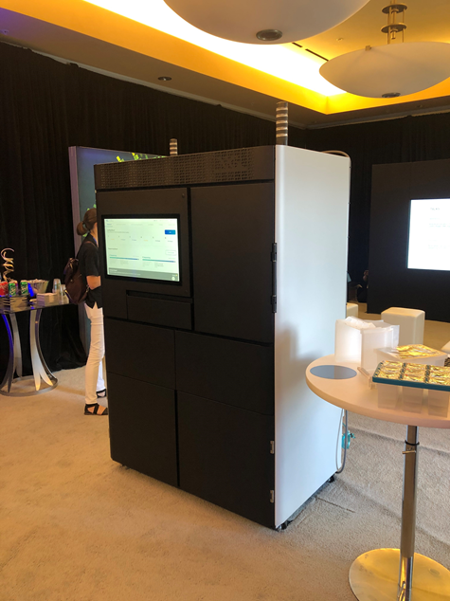
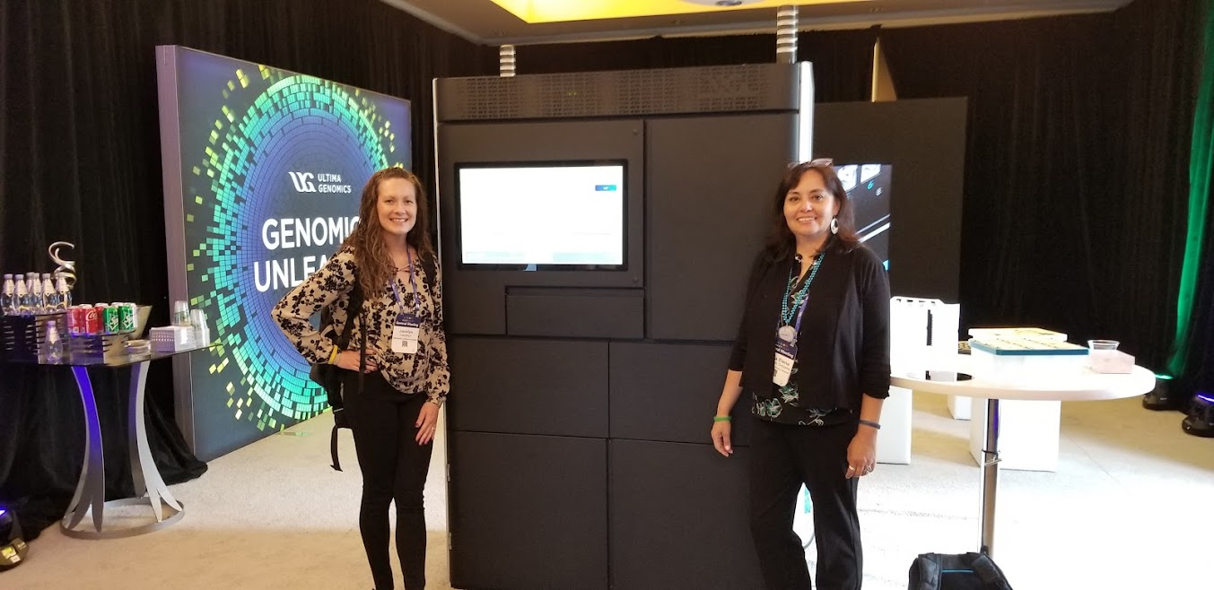
Ultima Genomics
The UG100
Footprint is the “Ultima”te of its kind
Three instruments total
Clustering
Sequencing
Computational

Slide 3
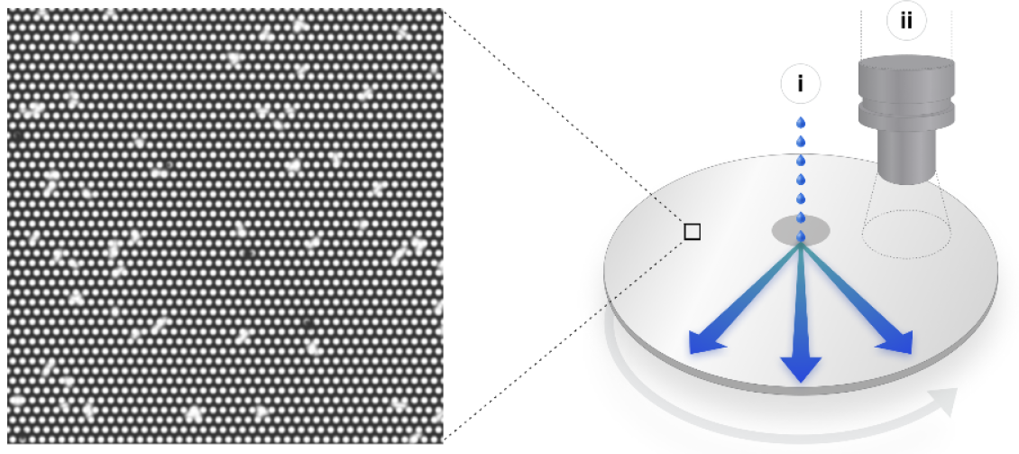
Ultima Genomics
Three main innovative components: (1) open fluidics and optics system
Circular silicon wafer as an “open flow-cell”
Patterned – dense array of electrostatic landing pads to bind sequencing beads
~10 billion clonally amplified beads
Spin-dispense system
Notes:
utilizing a circular 200mm silicon wafer as an “open flow-cell” with no consumable parts in the optical path. This wafer is patterned at micron scale generating a dense array of electrostatic landing pads to bind clonally amplified sequencing beads (emulsion PCR)
A spin dispense system delivers reagents to the wafer by dispensing reagents from dedicated nozzles near the center of the rotating wafer and distributing the reagents rapidly and uniformly across the wafer by centrifugal force
Wafers are cheap, large substrate surface, spin-dispense lowers dead-volume for reagents, design allows for rapid optical scanning

Slide 4
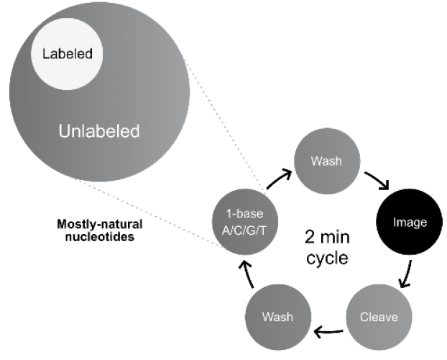
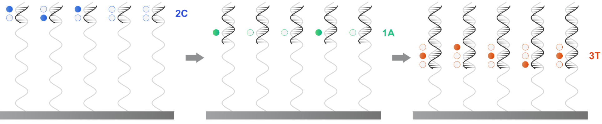
Ultima Genomics
Three main innovative components: (2) mostly natural sequencing chemistry
Sequencing-by-synthesis (mnSBS) uses a mixture of native dNTPs and one-at-a-time fluorescently labeled dNTP
Polymerase extends 0, 1 or several bases depending on respective homopolymer
Detected signal proportional to length of homopolymer
Notes:
Mostly natural sequencing-by-synthesis (mnSBS) comprises a minority (<20%) of fluorescently labeled, non-terminated nucleotides and a majority of unlabeled, non-terminated (natural) nucleotides (mostly natural nucleotide; MNN mix)
Resulting synthesized DNA is mostly unmodified by the incorporated base can still be detected based on the remaining hundreds of photons produced by each fluorescent label from that cluster.
For each sequencing cycle a single nucleotide base type of MNN mix is added to the clonal beads and polymerase extends 0,1 or several bases of that type depending on the length of the respective homopolymer in the corresponding template.
Following this chemistry step, entire active surface of substrate is scanned to measure the fluorescence level of each clonal bead. Fluorescence labels are cleaved, washed (~2min), amount of label nucleotide incorporated on a clonal bead is linearly proportional to the length of the respective homopolymer in the template, signal is proportional to the length of the homopolymer.
Use of mostly natural SBS eliminates most scarring effects of reversible-terminating chemistries, allowing for faster run times and longer read lengths.

Slide 5
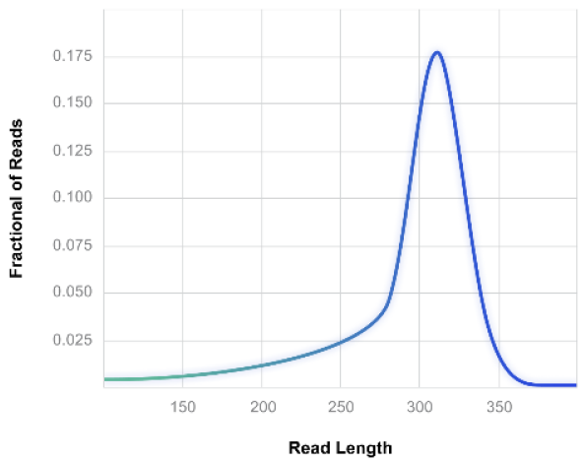
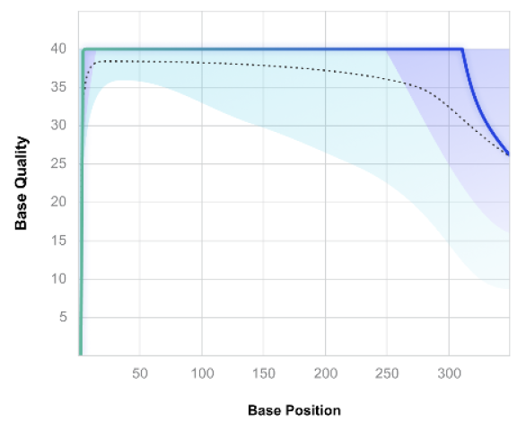
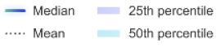
Ultima Genomics
Three main innovative components: (3) neural network-enabled base-calling
Machine learning and convolutional neural network (CNN) to convert raw signals to sequence reads; run-specific calibration process; CRAM file
HG001-HG007 Generated Data
444 cycles and a 20 hr run time
Mode 310 bp
94.5% of bases BQ≥20
Notes:
Compressed Reference-oriented Alignment Map (CRAM): CRAM is a more highly compressed alternative to the BAM and SAM DNA sequence alignment file formats. CRAM is a format designed by the European Bioinformatics Institute. It uses reference-based compression, meaning that only base calls that differ to a designated reference sequence need to be stored.
444 flow cycles
20 hr run time
Avg. 282 bp; mode 310 bp
60x mean coverage (40x used for analysis)

Slide 6
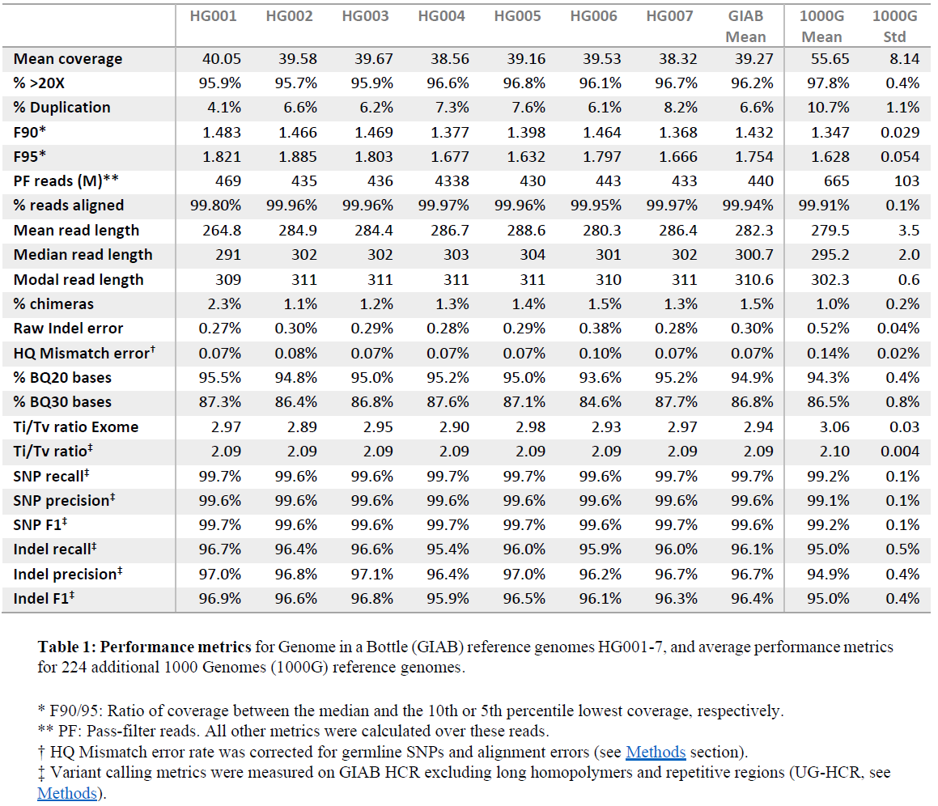
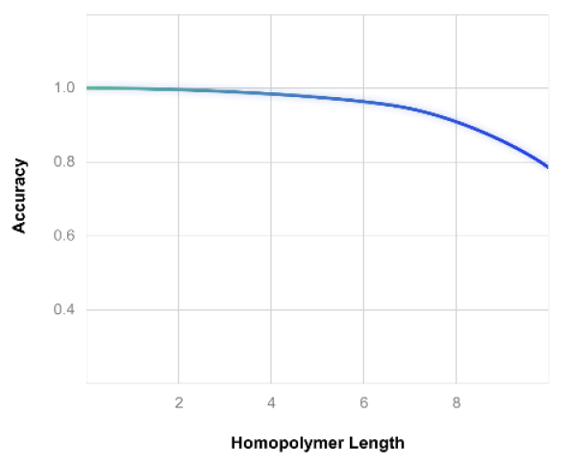
Ultima Genomics
Three main innovative components: (3) neural network-enabled base-calling
90% accuracy for homopolymer at 8 bp
GIAB Mean
SNP: 99.7% recall; 99.6% precision
Indel: 96.1% recall; 96.7% precision
Notes:
Compressed Reference-oriented Alignment Map (CRAM): CRAM is a more highly compressed alternative to the BAM and SAM DNA sequence alignment file formats. CRAM is a format designed by the European Bioinformatics Institute. It uses reference-based compression, meaning that only base calls that differ to a designated reference sequence need to be stored.
444 flow cycles
20 hr run time
Avg. 282 bp; mode 310 bp
60x mean coverage (40x used for analysis)

Slide 7
Ultima Genomics in Summary
Technology: mostly natural sequencing-by-synthesis (mnSBS)
Output: 10 billion clonally amplified beads; 2 Wafers at a time
Runtime: 20 hr
Length of reads: 310 bp mode size (GIAB)
Accuracy:
SNP: 99.7% recall; 99.6% precision
Indel: 96.1% recall; 96.7% precision
Instrument cost: Unknown (comparable to Illumina NovaSeq 6000)
Instrument size (relative): Several NovaSeqs worth
Partnerships/acquisitions:
AI partnerships with Google DeepVariant, NVIDIA and Senteon
Exact Sciences, Regeneron Pharmaceuticals, NYGC and Broad Institute: beta testing

Slide 8
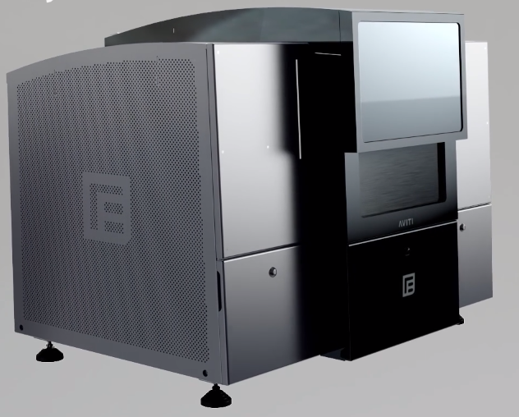
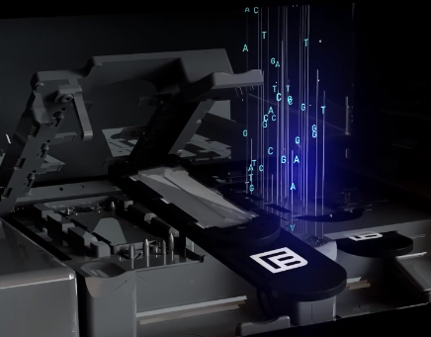
Element Biosciences – AVITI Benchtop Sequencer
Highlights
Two independent, random-access flow cells (~240Gb/800 million paired-end reads output per flow cell)
FASTQ file output (conversion performed by AVITI Operating Software Bases2Fastq workflow)
Two library workflows (Adept – conversion of existing libraries ; Elevate – library preparation)
Tunable optical throughput (full scan, ½ scan, ¼ scan etc..) to select desired TAT/read depth
Notes:
Independent – different types of read lengths, different cartridges, different run recipes, different throughputs

Slide 9

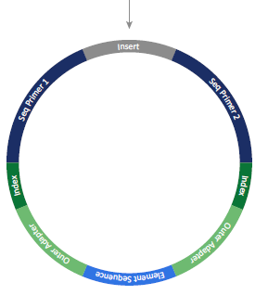
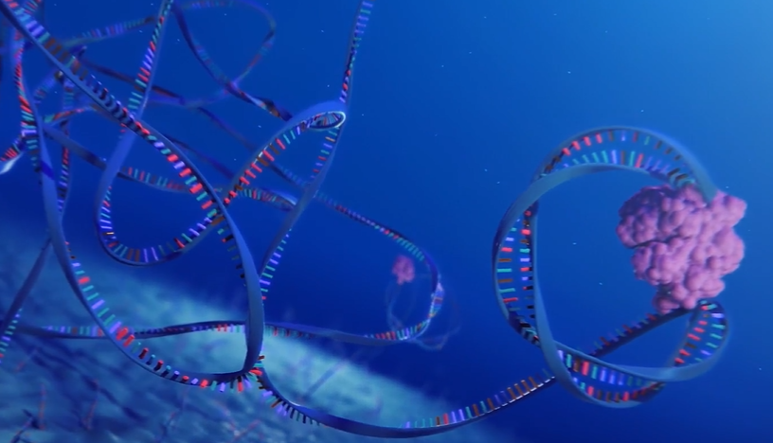
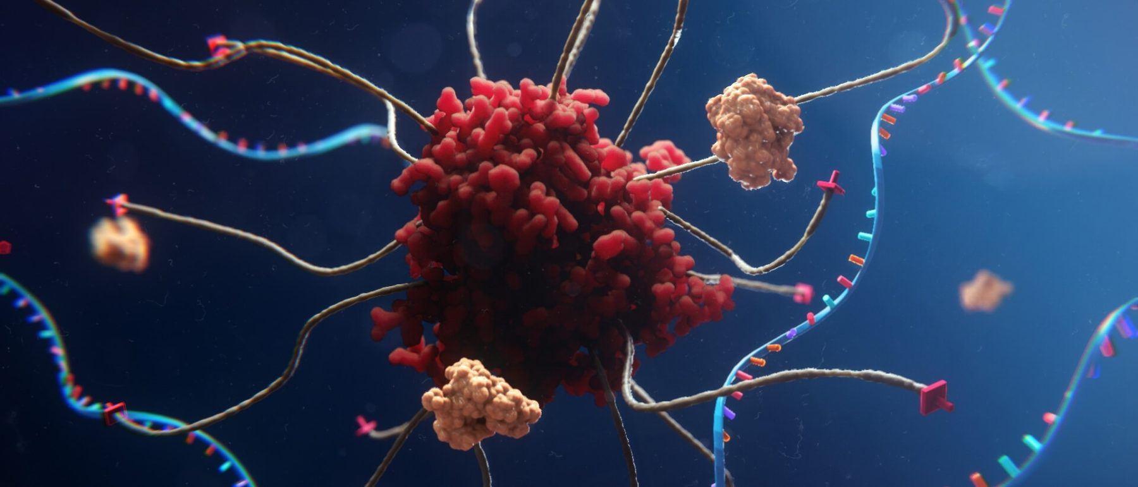
Element Biosciences - AVITI
Circularization
Off-instrument library circularized prior to sequencing
"Working to move onto the flow cell"
Pollination
Rolling circular amplification on flow cell surface creates clonal copies of the library molecule or "polony"
Sequencing
Instead of binding an individual labeled nucleotide at each location of the cluster, AVITI uses single fluor with many octopus-like tentacle arms (Avidite)
Avidite nucleotide substrate
Each arm, single nt type
One avidite = multiple binding sites within the polony = increased binding avidity
Element Biosciences - Resources
Notes:
The linear library is denatured and annealed to a splint oligo. A ligation reaction circularizes the library that is then cleaned up using enzymatic digestion and purification beads.
A circularization reaction supports one linear library or a pool of up to 96 indexed linear libraries as input.
Pollination
Instead of binding a single labeled nucleotide at each of those thousands of locations in the cluster, AVITI technology uses a different approach: a single fluor with many octopus-like tentacle arms, each arm having a single nucleotide type.
The AVITI octopus-like labeled molecule is called an Avidite and has four different colors, and four different nucleotides. 100s of avidites bind per DNA feature, generates scalable signal. On the core of the avidite—the body of the octopus—are multiple fluorophores that are measured by an optical imaging system. The avidity comes when one avidite, with multiple nucleotides, binds on multiple contact points to create a tighter binding.
They claim translates to a stronger/scalable signal, less background, lower concentrations of needed reagents, ultimately lower cost

Slide 10
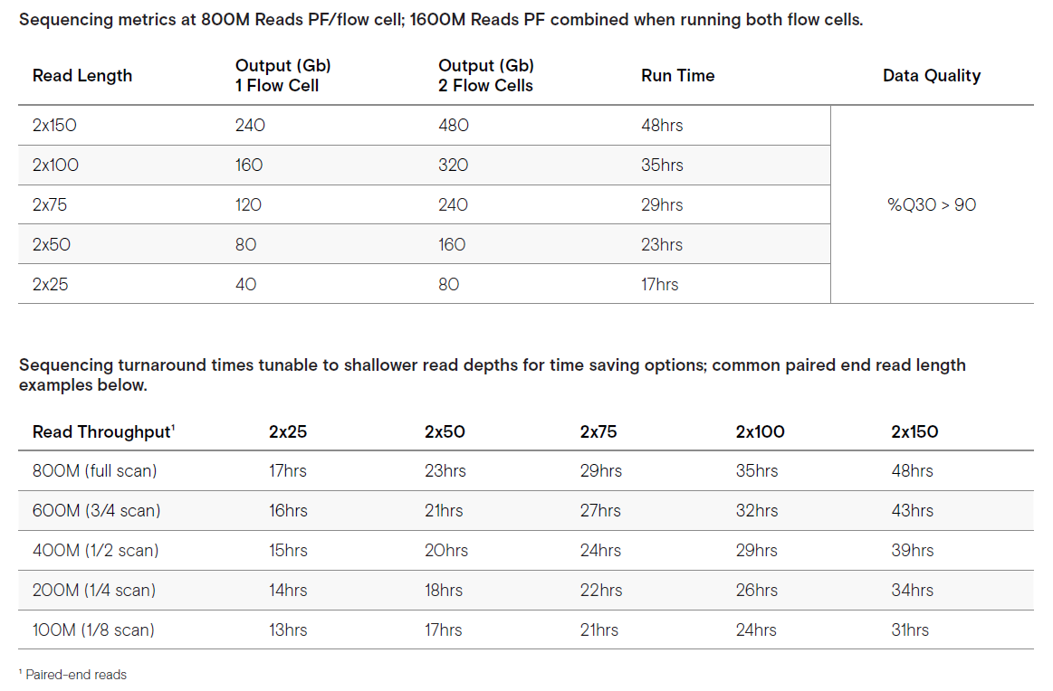
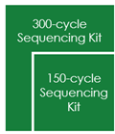
Element Biosciences - AVITI
Output
Tunable
run
time
Notes:
Partial read of the flow cell

Slide 11
Element Bioscience (AVITI) in Summary
Technology: Sequencing-by-synthesis
Output:
2 x 150 240Gb / 800M read pairs per flow cell
2 x 150 260-300Gb / >800M read pairs per flow cell (Broad Institute beta test)
2 x 75 120Gb / 800M read pairs per flow cell
2 x 75 130-150Gb / >800M read pairs per flow cell (Broad Institute beta test)
Runtime: 2 x 150bp (full-scan) - 48 hours
Accuracy:
SNP: 99.8% recall / 99.2% precision
Indel: 99.7% recall / 99.2% precision
>90% Q30 (2 x 150, PCR-free libraries)
>97% Q30 (Broad Institute beta test, 2 x 150, PCR-free libraries, GIAB)
>87% Q40 (Broad Institute beta test, 2 x 150, PCR-free libraries, GIAB)
Instrument cost: $289K
300-cycle sequencing cartridge: $1,680
150-cycle sequencing cartridge: $1,080 (Q4 2022)
Price per Gb: $5 - $7 USD
Instrument size (relative): Large benchtop (29" x 36" x 29")
Partnerships: Fabric Genomics/Senteon/Jumpcode/Dovetail/NEB/QIAGEN/Agilent
Notes:
Polished experience

Slide 12
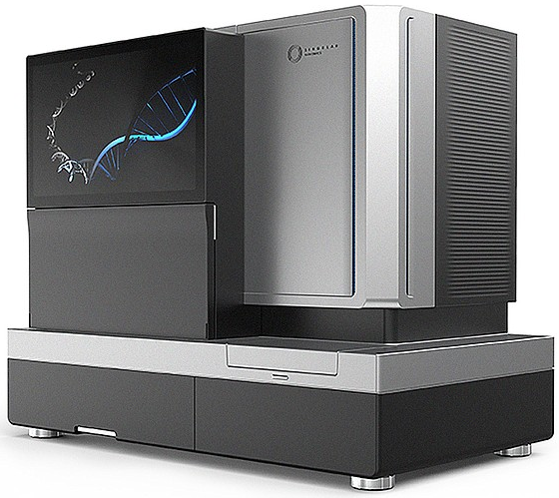
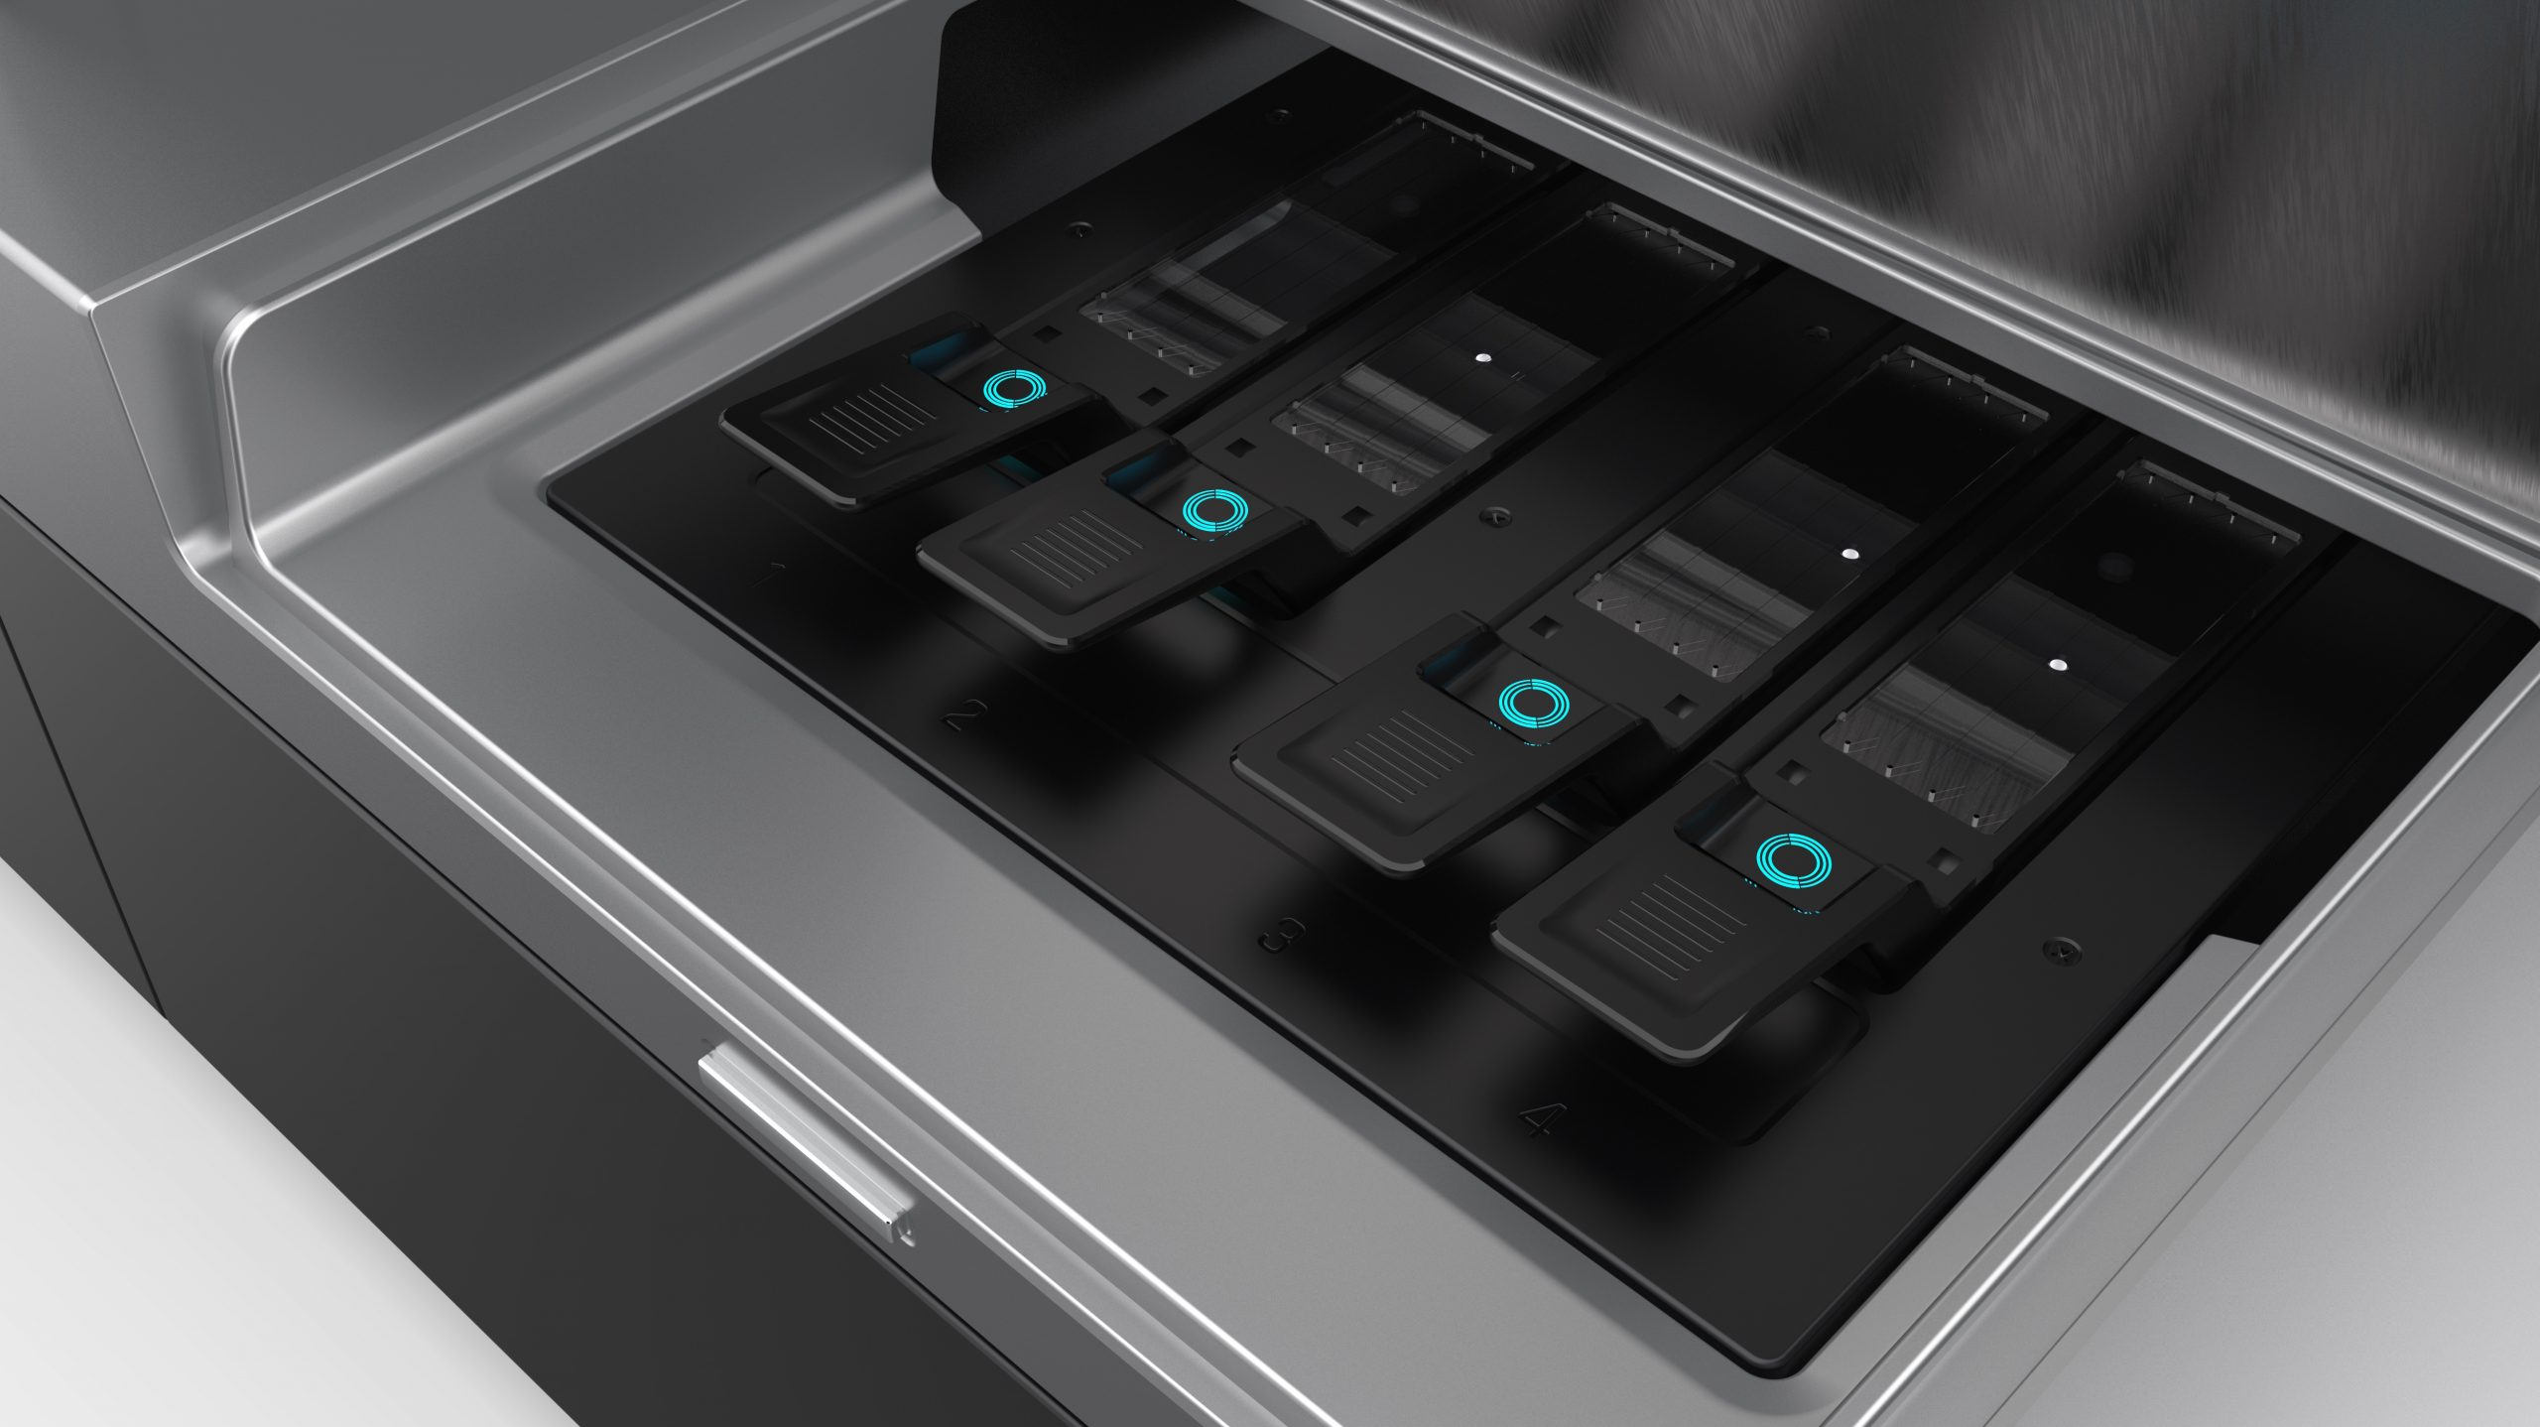
Singular Genomics G4 Platform
G4 Sequencing Platform
Bench Top

Slide 13
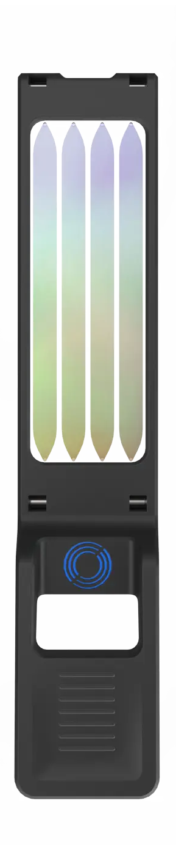
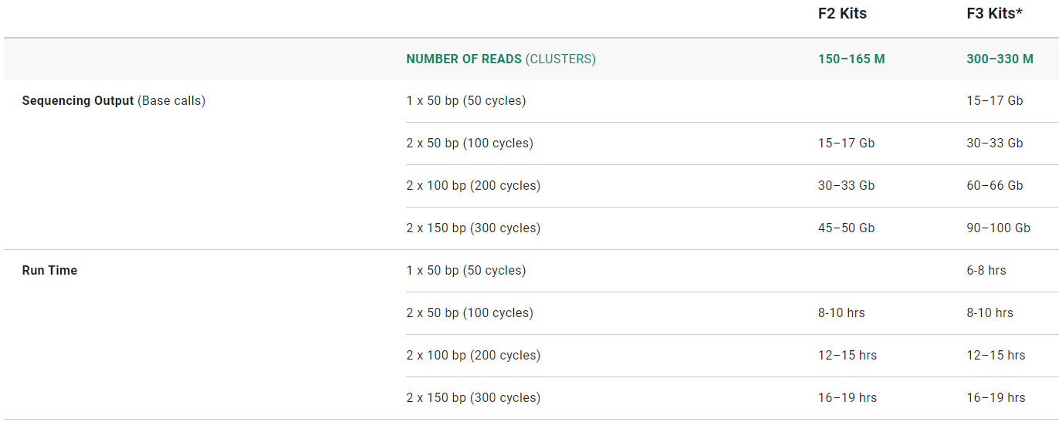
Singular Genomics
Sequencing
Rapid SBS chemistry – 4 color
On board cluster generation
Engineered polymerase
Flow Cell Design
4 lanes per flow cell
Lane segregation
4 flow cells per sequencing run
*F3 planned for next release
Notes:
The G4 takes advantage of the fundamental strengths of the SBS approach but is engineered from the ground up using novel chemistry, sequencing enzymes, polymer scaffolds, micro-fabrication techniques and molecular biology workflows, in addition to engineering innovations in high-speed imaging and rapid fluid exchanges during sequencing cycles.

Slide 14
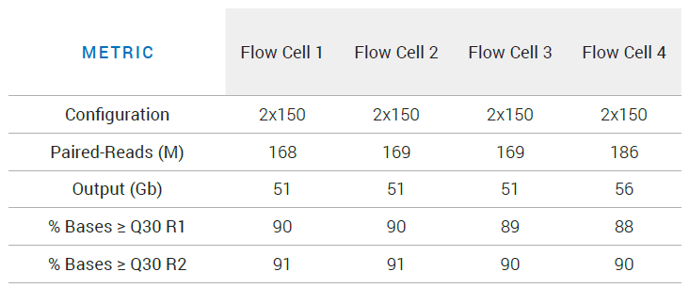
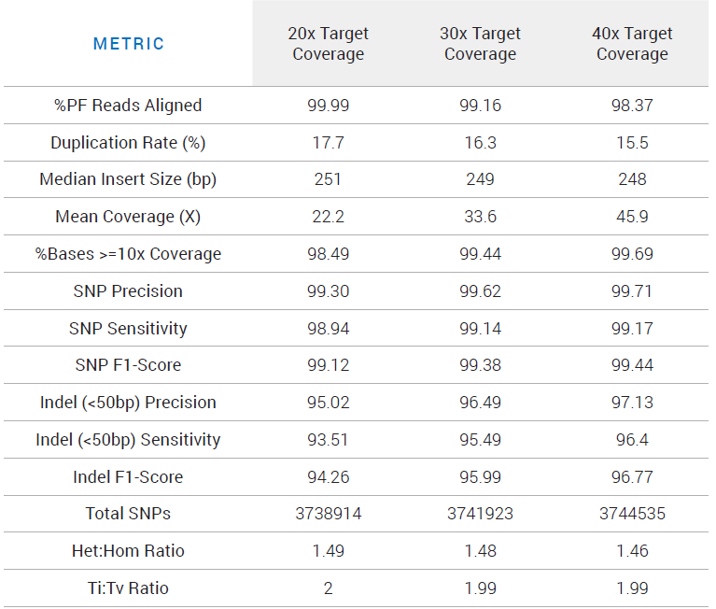
Singular Genomics Performance
Two Separate Reactions of NA12878 WGS
40x WGS Coverage
SNP:
99.17% Sensitivity
99.71% Precision
Indel:
96.4% Sensitivity
97.13% Precision
Notes:
we performed germline variant analysis of aligned data using an implementation of DeepVariant5 that had been optimized for another common SBS-based platform

Slide 15
Singular Genomics: Summary
Technology: Rapid SBS – 4 Color Chemistry
Output: 150 – 165 million clusters (F2 flow cell)/four flow cells per instrument
Runtime (2 x 150 bp): 16 – 19 hr
Length of reads: 2 x 150 bp
Accuracy:
SNP: 99.17% Sensitivity; 99.71% Precision
Indel: 96.4% Sensitivity; 97.13% Precision
Instrument cost: $350,000
Instrument size (relative): Bench Top; Slightly bigger than a MiSeq
Partnerships/acquisitions:
Dovetail Genomics, Lexogen, NEB, Twist Bioscience, Watchmaker Genomics, Broad Institute’s Terra Platform

Slide 16
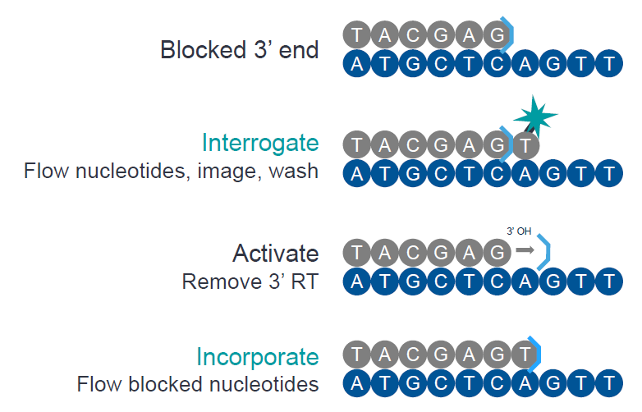
PacBio: Onso
Sequencing By Binding (SBB) Technology: interrogation followed by incorporation
Better for homopolymer stretches
Chemistry doesn’t die at the end of the read
Output: Up to 500M reads
Demultiplexed FASTQ
Runtime: <24 hours
Length of reads: 2x150, or 1x200
Illumina libraries
Accuracy:
Google DeepVariant calling
99.25% Indels
99.7% SNVs
Notes:
SBB:
>90% bases at Q40+
Low duplications rate
No index hopping
Sequence through difficult /repetitive regions

Slide 17
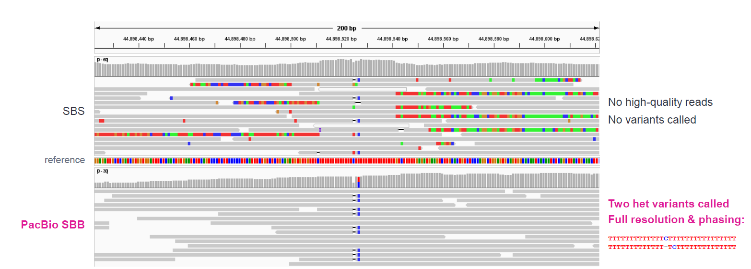
PacBio: Sequencing by Binding (SBB)
TOMM40; chr19:44,898,425-44,898,624
NovaSeq 2x151 vs PacBio SBB 1x200

Slide 18
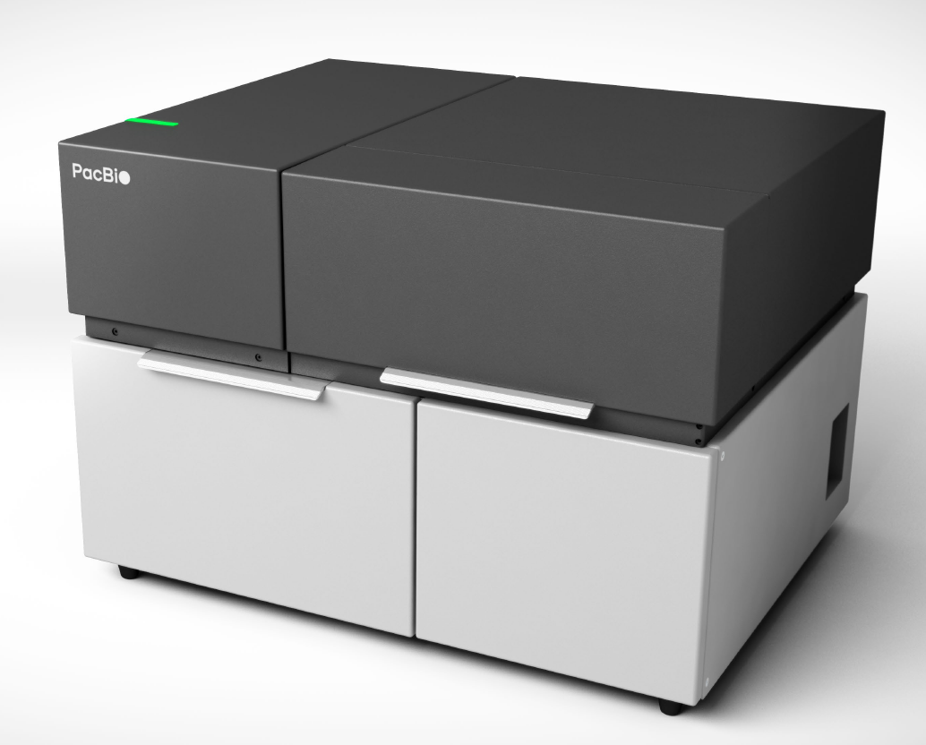
PacBio: Onso
Instrument cost: $259,000
Instrument size: Benchtop
Partnerships/acquisitions: Omniome
Commercial availability: First half of 2023
Other details
Jonas Korlach’s presentation: IGM Tech Dev\AGBT2022\PacBio
Summary of technology: PacBio Doubles Down on Accuracy by Acquiring Omniome

Slide 19
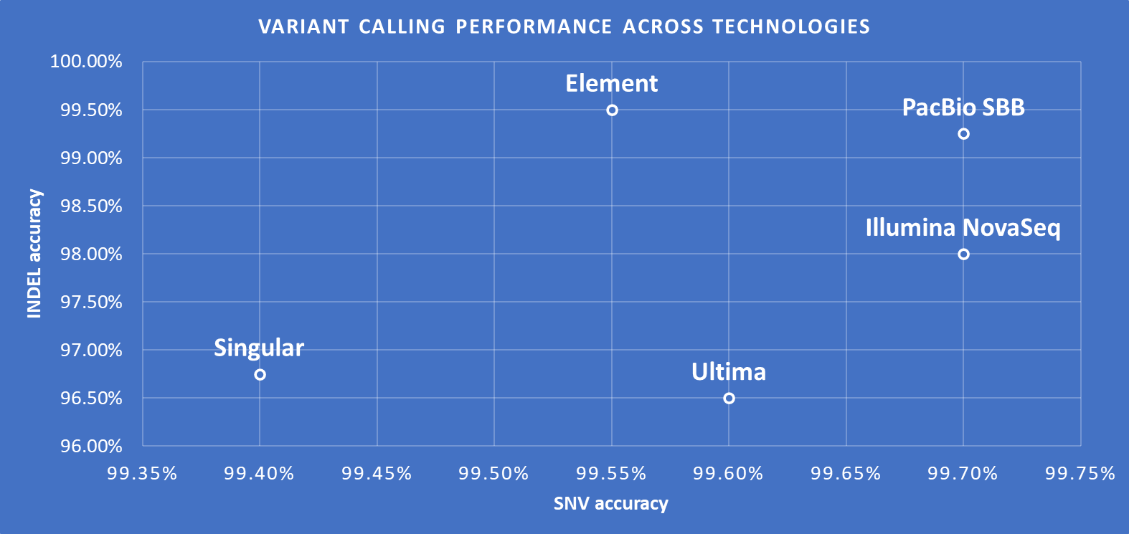
PacBio SBB Performance Comparison
Metrics from PacBio’s AGBT 2022 presentation
Notes:
Most accurate, so do we need as much coverage as Illumina to be confident in our calls? Or is mid-output good enough?
Can get down to 0.001% with only 10M reads, no UMIs (Illumina PCR-free library?)

Slide 20
Illumina NovaSeq X Series
Key features:
Shipping starts 1Q 2023 – X Plus price is 1.25 million (NovaSeq X is $985,000)
NovaSeqX is single flowcell; XPlus is two flowcells
8 lanes; segregation possible
New optics, new chemistry, new flowcell design, and software updates
50x more stable chemistry – ambient temp for reagents
90% reduction in packaging
2.5x faster base calling
Greater accuracy – 50% reduction in sequencing error rate and phasing
5x reduced data footprint (lossless genomic data compression)
320% higher density on flowcell – 10 billion clusters – 6 TB (2x150) in 24 hrs for NovaSeq X - $200 genome (including clustering, sequencing, primary and secondary analysis)
Demultiplexing while sequencing
The NovaSeq X series achieves ultra-high-resolution imaging through higher numerical aperture, a custom CMOS sensor, and two-channel SBS with blue-green optics
Chemistry “X”: XLEAP-SBS chemistry
2024 availability for NextSeq1000/2000 – no compatibility for NovaSeq6000
Used within NovaSeq X
Illumina Complete Long-Read
1Q 2023 – WGS protocol w/ 6-7 kb reads on avg with up to 30 kb
NextSeq, NovaSeq6000 and NovaSeq X compatible

Slide 21
Illumina NovaSeq X Series
 | Output per flow cell run |  |  | Reads passing filter per flow cell | Instrument run time
Platform/Flow Cell | 2 x 50 bp | 2 x 100 bp | 2 x 150 bp | Paired-End Reads | 2 x 50 bp | 2 x 100 bp | 2 x 150 bp
Illumina NovaSeq SP | 65 – 80 Gb | 134 – 167 Gb | 200 – 250 Gb | 1.3 – 1.6 billion | ~ 13 hr | ~ 19 hr | ~ 25 hr
Illumina NovaSeq S1 | 134 – 167 Gb | 266 – 333 Gb | 400 – 500 Gb | 2.6 – 3.2 billion | ~ 13 hr | ~ 19 hr | ~ 25 hr
Illumina NovaSeq S2 | 333 – 417 Gb | 667 – 833 Gb | 1000 – 1250 Gb | 6.6 – 8.2 billion | ~ 16 hr | ~ 25 hr | ~ 36 hr
Illumina NovaSeq S4 | N/A | 1600 – 2000 Gb | 2400 – 3000 Gb | 16 – 20 billion | N/A | ~ 36 hr | ~ 44 hr
Illumina NovaSeq X 1.5B | 165 Gb | 330 Gb | 500 Gb | 3.2 billion | ~ 13 hr | ~ 18 hr | ~ 21 hr
Illumina NovaSeq X 10B | 1000 Gb | 2000 Gb | 3000 Gb | 20 billion | ~ 18 hr | ~ 22 hr | ~ 24 hr
Illumina NovaSeq X 25B | N/A | N/A | 8000 Gb | 52 billion | N/A | N/A | ~ 48 hr

Slide 22
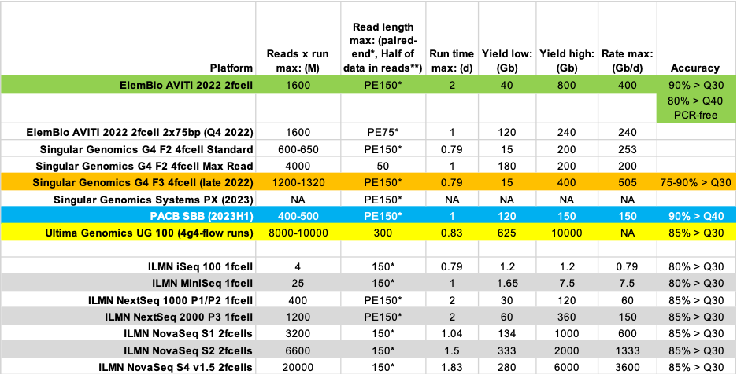
Short-Read Sequencer Summary

Slide 23
Short-Read Sequencer Summary
Instrument | Chemistry | Max Output | Runtime | Length of reads | SNP recall | SNP precision | Indel recall | Indel precision
Ultima UG100 | mnSBS | 10B clonally amplified beads | 20 hr | 310 bp (GIAB) | 99.7% | 99.6% | 96.1% | 96.7%
Element AVITI | SBS | 2 x 150 240 Gb / 800M read pairs | 48 hr | 150 bp | 99.8% | 99.2% | 99.7% | 99.2%
Singular G4 | SBS | 2 x 150 50 Gb / 165M clusters | 16 hr | 150 bp | 99.17% | 99.71% | 96.4% | 97.13%
PacBio SBB Instrument | SBB | 2 x 150 | < 24 hr | 150 bp | 99.7% |  | 99.25%
Illumina NextSeq 2000 | SBS | 2 x 300 360 Gb 2.4B PE reads |  | 300 bp | 98% |  | 98%

